Slide 1
Real or AI?
Can you sort the real photos from the fakes?

Slide 2


Slide 3
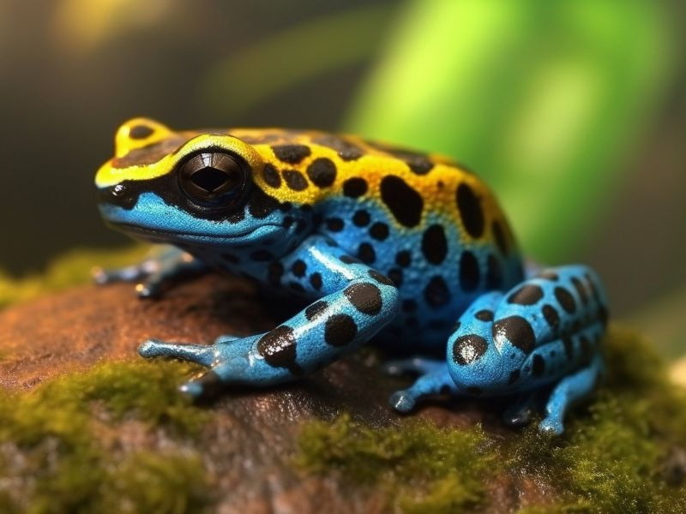
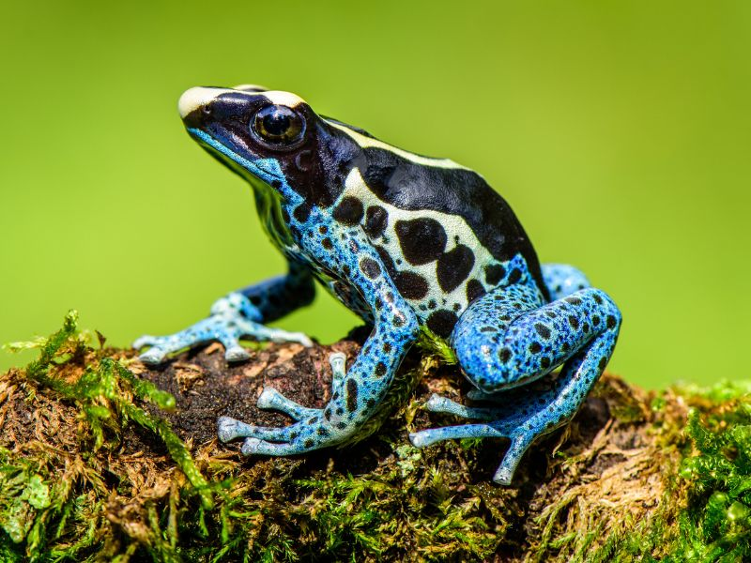
AI images love super bright colours. But watch out! Some real creatures, like poisonous frogs, are naturally vibrant. You can't guess by colour alone.

Slide 4
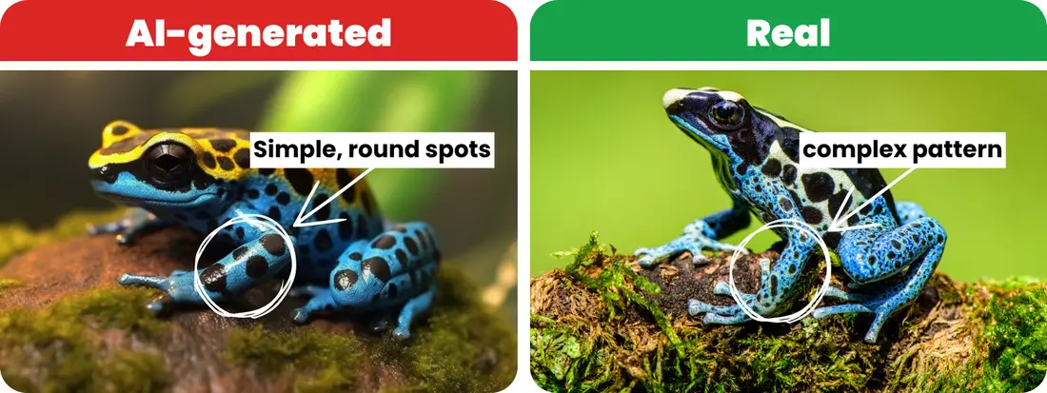
Even though the AI picture has brighter colors, there is a better way to spot the real photo: look closely at the frog's skin! The real frog has tiny, detailed patterns and unique spots. The AI frog looks a bit too perfect and has much simpler spots.

Slide 5
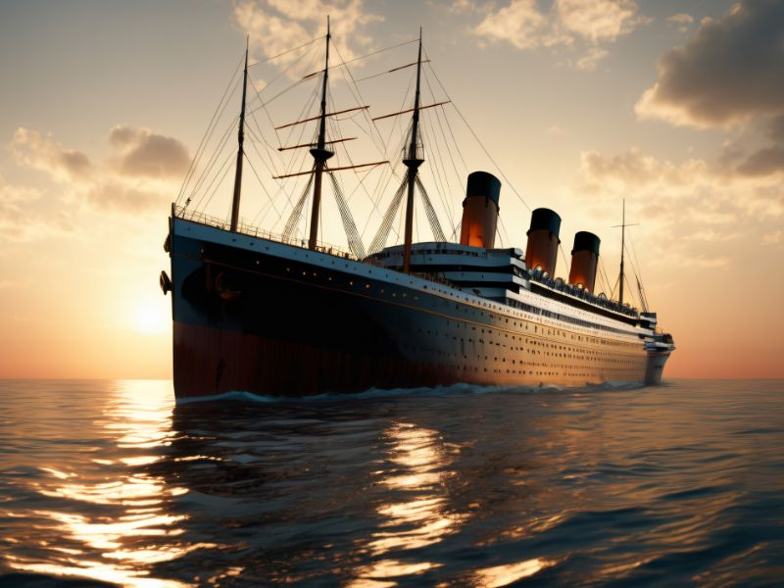
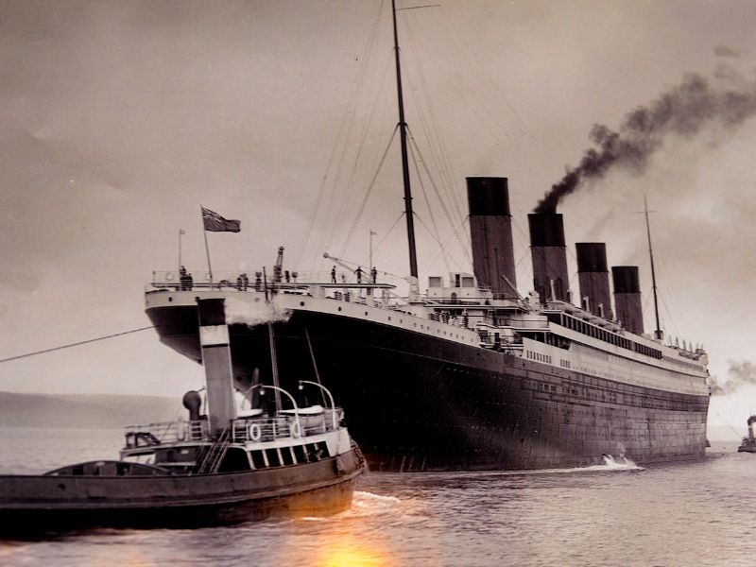
Old history photos should look old. Look for faded colours or a brown tint. AI struggles to make old photo styles look real.

Slide 6
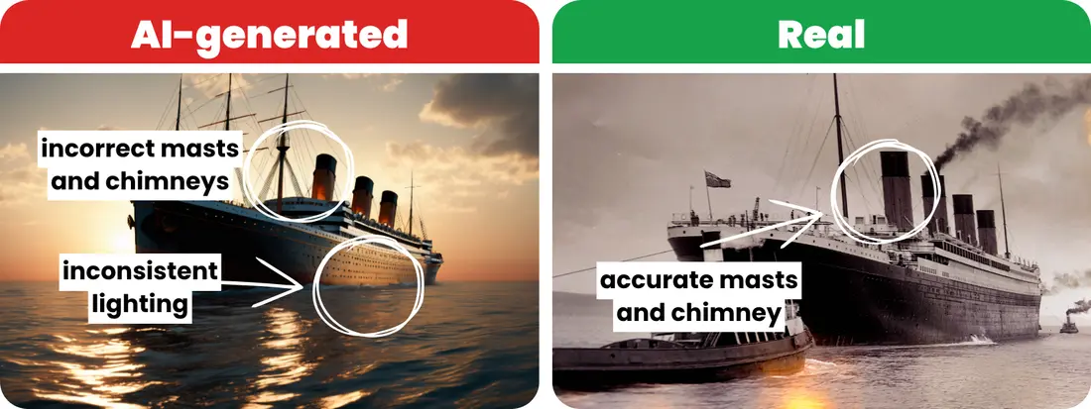
Count the parts! The real Titanic had one tall pole (a mast) and four chimneys. The AI drew three of each. Also, the AI's sunbeams magically shine right through the middle of the dark ship.

Slide 7
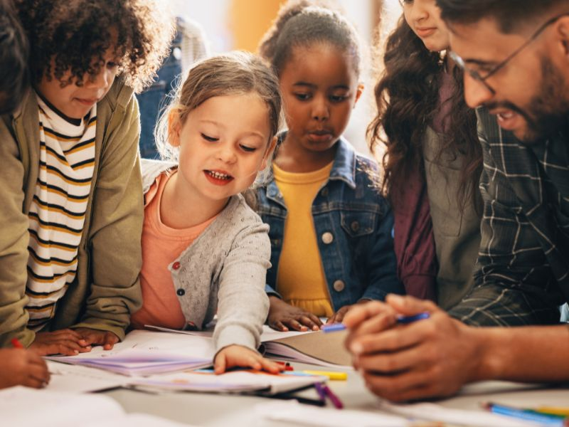
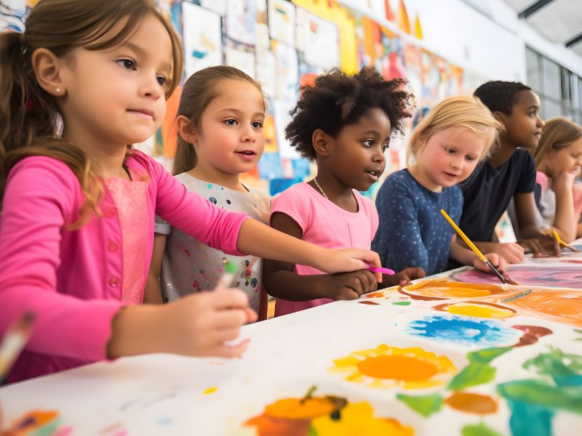
AI is still learning how to draw humans. It regularly messes up the tricky parts, like your arms, fingers, and toes.

Slide 8
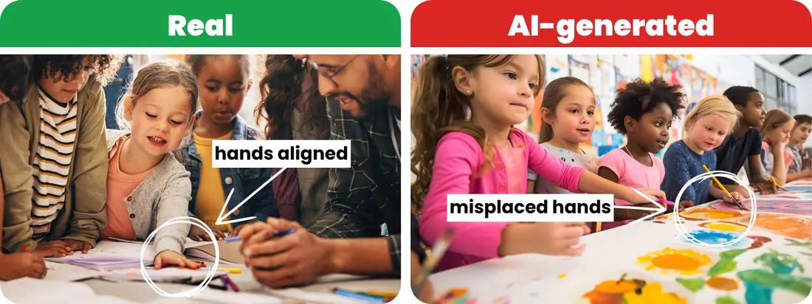
Look closely at the hands. Do you see how some arms look like they are in the wrong place, or completely missing? Some hands don't even belong to the child next to them.

Slide 9
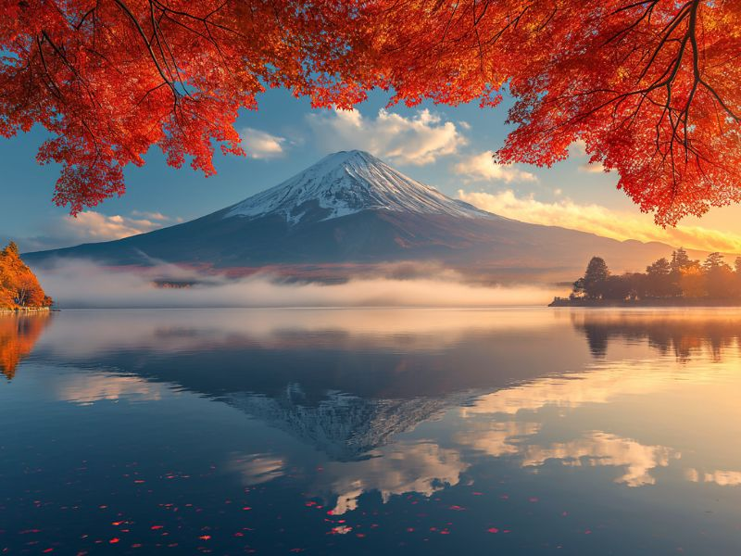
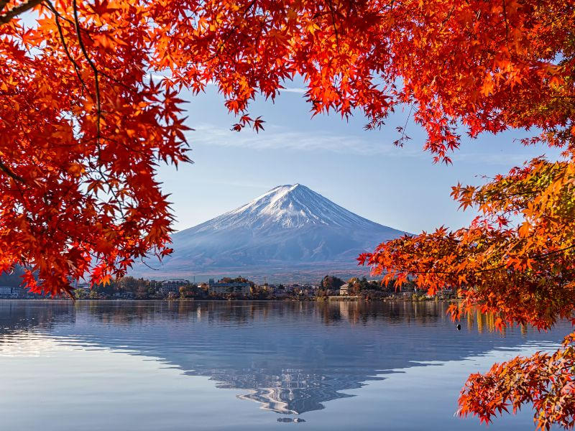
This one is tricky! Both pictures of Japan's highest mountain look beautiful and very real. Even the water reflections look good.

Slide 10
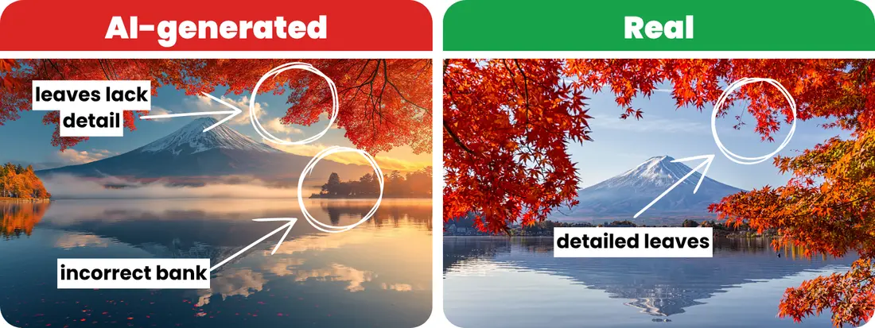
AI likes to add fake trees to make scenes look pretty. But if you check the real photo, you'll see crisp details in the leaves, while the AI ones look blurry and repeated.

Slide 11
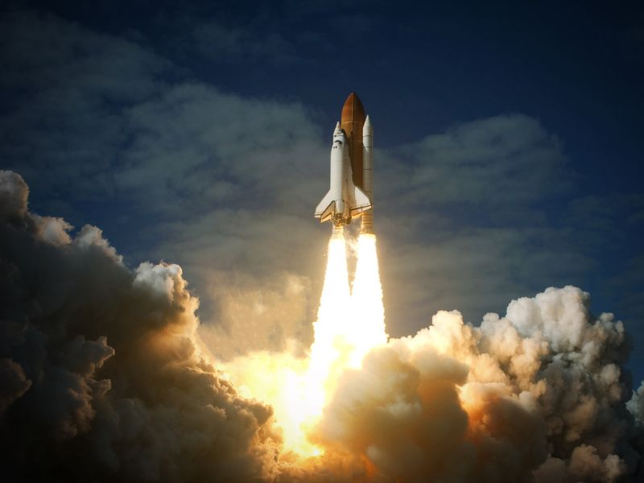
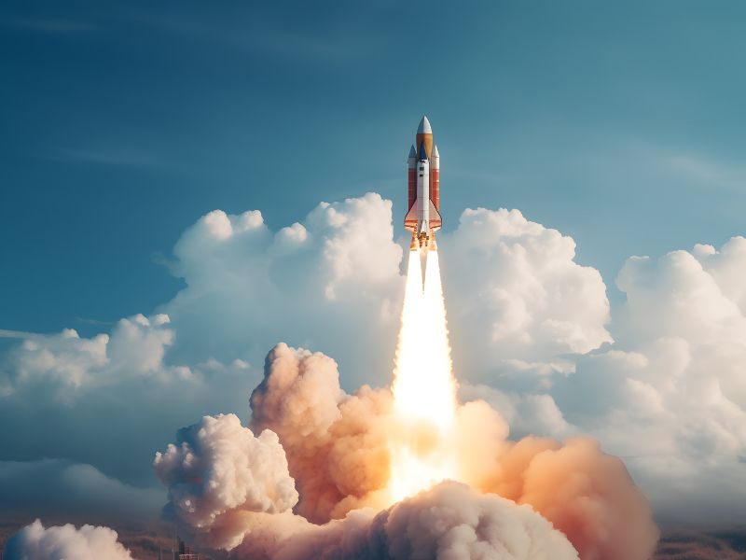
At first glance, these rocket launches look exactly the same. The clouds and bright lights make it hard to tell them apart.

Slide 12
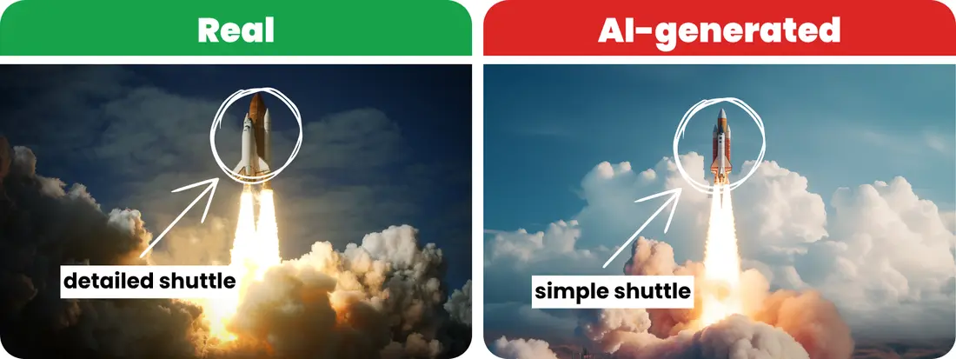
Zoom right in on the space shuttle. The AI spaceship looks smooth like a toy, but the real one has lots of complicated lines, bumps, and shadows.

Slide 13
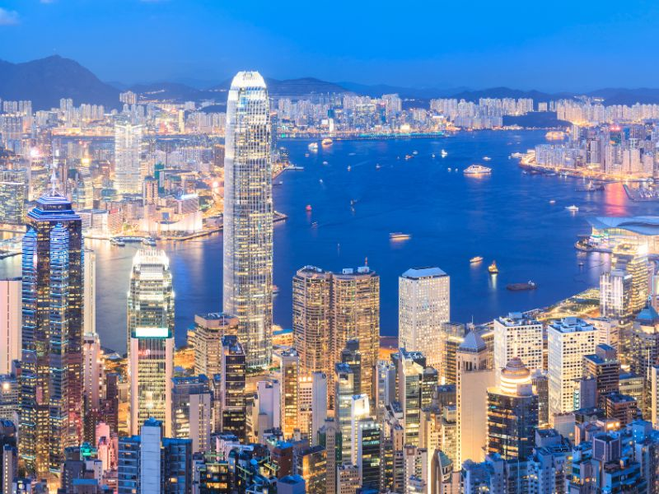
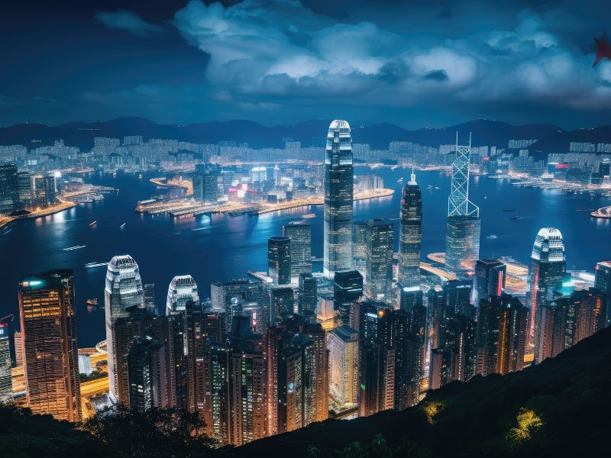
Big cities at night are hard to judge. Both the real photo and the AI photo have great lights and shadows.

Slide 14
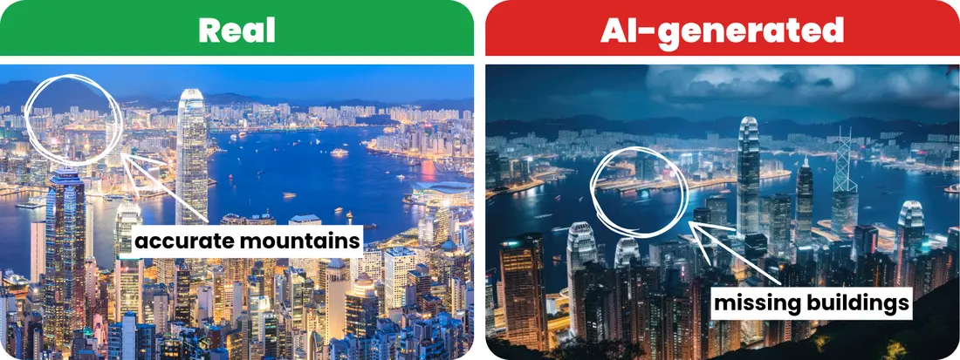
Check the shapes of the buildings and mountains. A quick online search of the real Hong Kong shows that the AI got the building heights wrong, and real mountains are much more uneven.

Slide 15
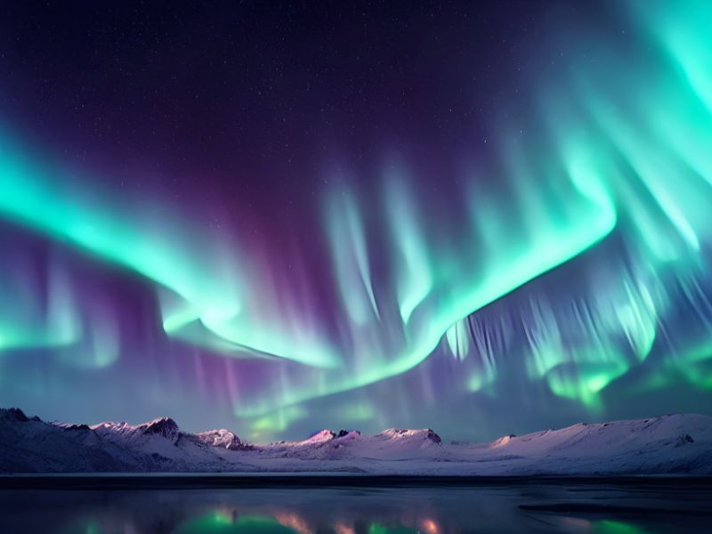
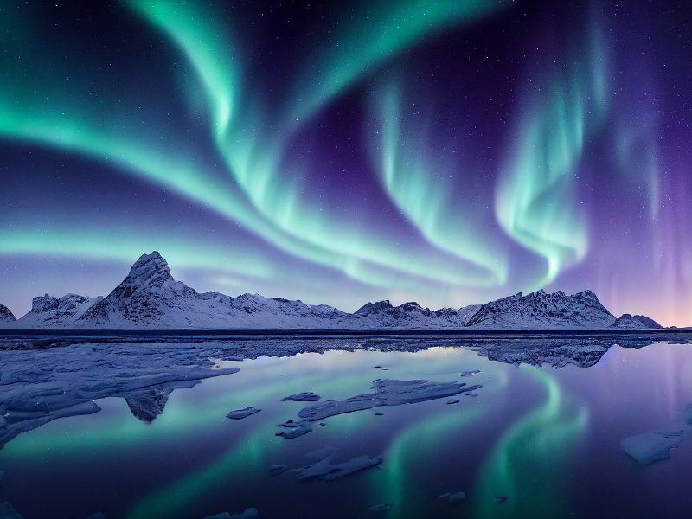
Spotting AI in nature is a huge challenge. If you have never seen the glowing Northern Lights in person, it is hard to know what is real and what is fantasy.

Slide 16
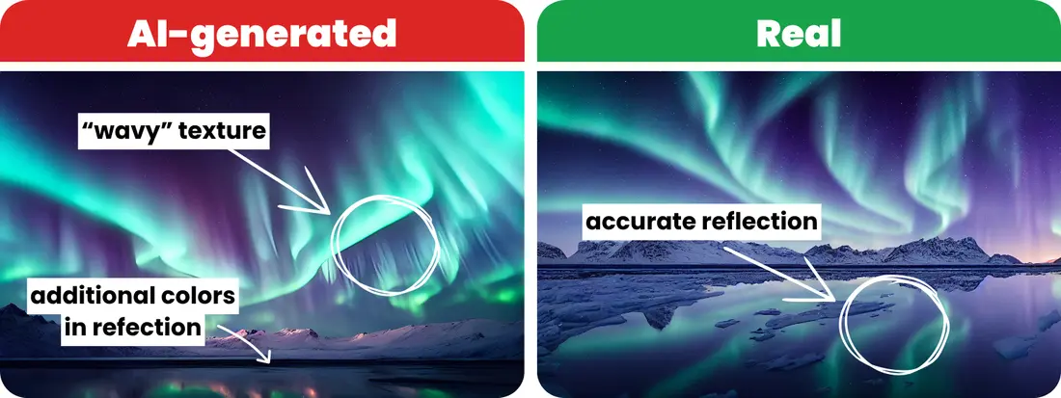
Turn your eyes to the water. In your real photo, the reflection mirrors the sky perfectly. In the AI photo, the computer just splashed messy pink and green paint into the water.

Slide 17
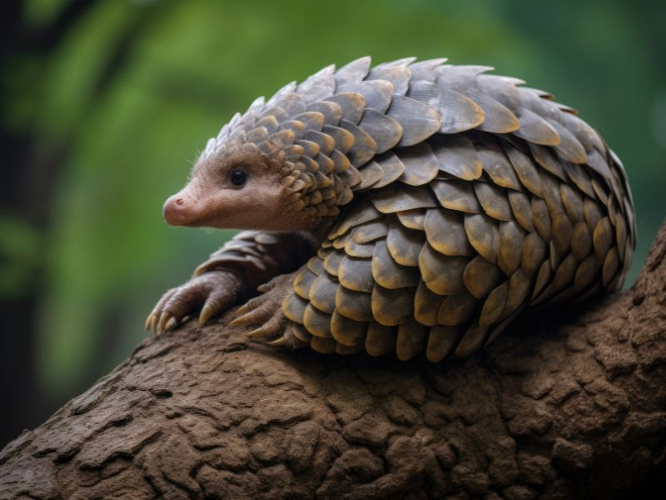
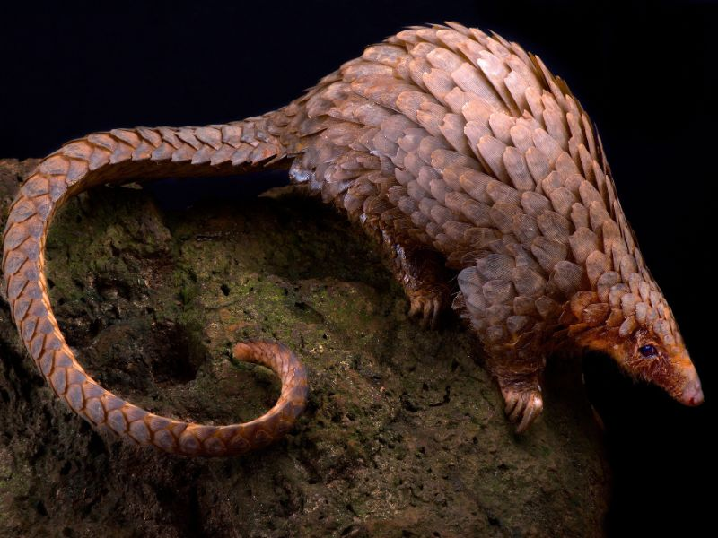
It is hard to spot AI errors on a rare animal you've never seen before, like a scaly pangolin. Because it's unfamiliar to you, you might not know what its body is supposed to look like.

Slide 18
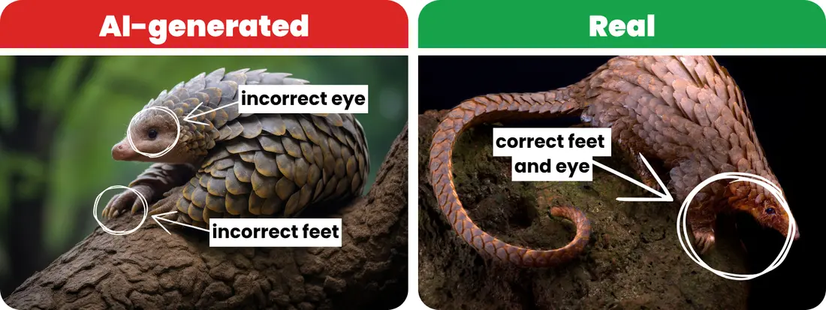
Look past the cool scales and check the face. AI struggles with animal eyes, making them look blank. Also, check the body shapes—do the legs look way too big for the head?

Slide 19
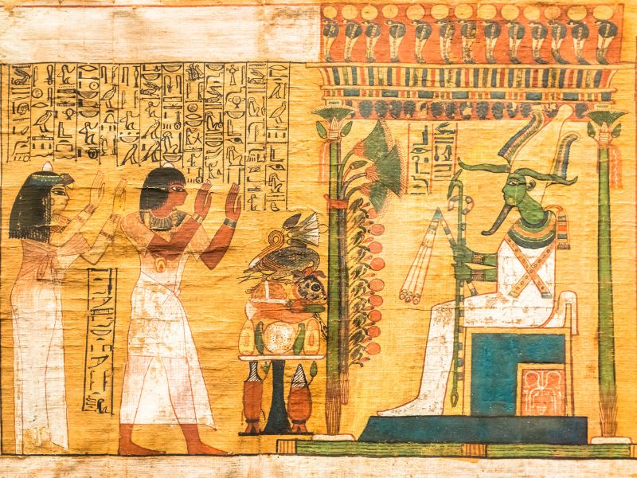
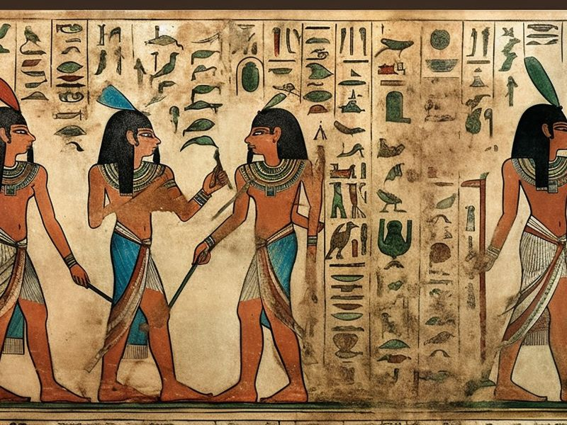
AI loves to fake old history papers. Both of these ancient Egyptian scrolls look properly dusty and thousands of years old.

Slide 20
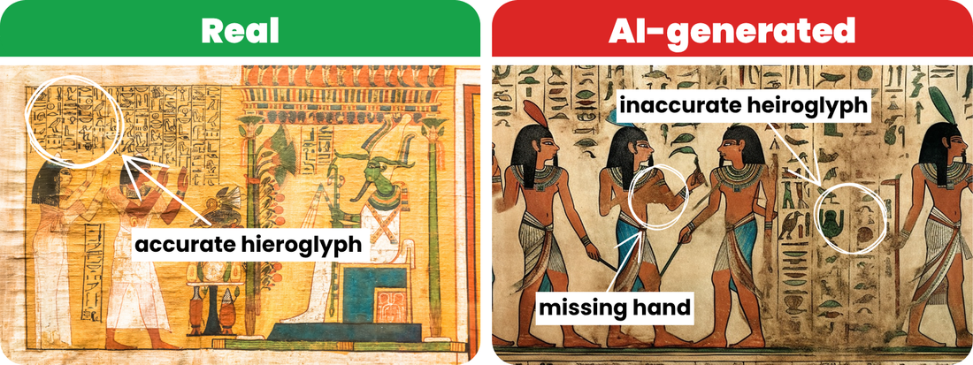
Look at the painted people! Zoom in and you will see floating arms and missing hands. Also, look at the picture-writing (hieroglyphs)—the AI just made up fake symbols that mean nothing.

Slide 21
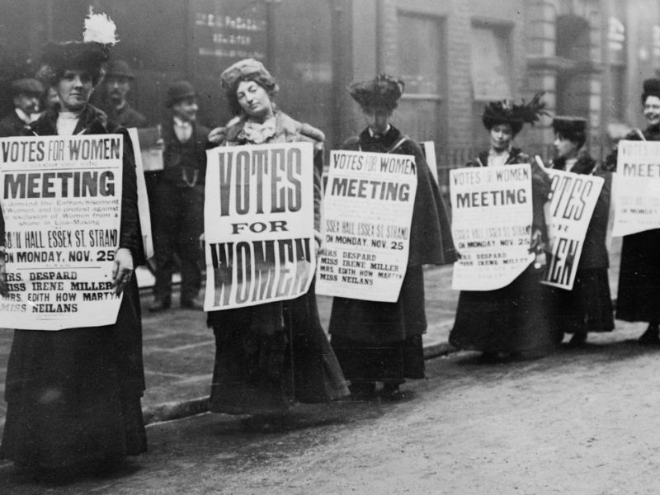
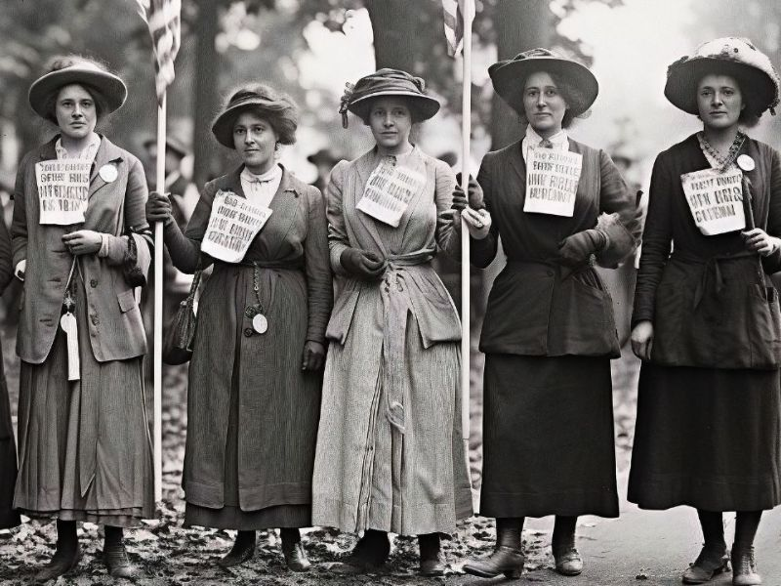
You can spot the fake here by looking closely at the people and the signs they are holding up.

Slide 22
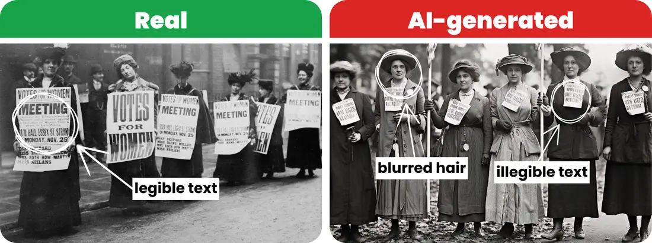
Have a look at the women's hats and hair—the AI made them look blurry. Then look at the text on their signs. The letters are jumbled up, messy, and spell out completely fake words that make no sense!

